Slide 1

EXPERIENTIAL LEARNING
QR- CODE GENERATOR
BY KHUSHI RATHI
219309030
SECTION W

Slide 2
CONTENTS
1.
2.
3.
4.
5.
6.
7.
PROBLEM STATEMENT INTRODUCTION MOTIVATION TECHNOLOGY USED
METHODOLOGY(FLOW CHART) GANTT CHART
REFERENCES

Slide 3

To develope a tool which generates QR-codes by taking employee details
PROBLEM STATEMENT

Slide 4

Introduction to QR codes
A ‘Quick Response Code’ also known as QR code is a two-dimensional type of barcode that Denso Wave develops, a Japanese barcode developer, in 1994.
QR codes are scan-able using smartphones devices, which are natively developed to scan/detect QR codes. These codes are generated using an online QR code generator that displays an online information to the scanner when scanned.

Slide 5

MOTIVATION
LEARNING AND FAMILIARIZING WITH A NEW PROGRAMMING LANGUAGE THAT IS PYTHON.
AN EASY TO USE TOOL THAT WILL GENERATE READABLE QR CODES USING EMPLOYEE DETAILS.

Slide 6
TECHNOLOGY USED
PROGRAMMING LANGUAGE
IDE
PYTHON
VISUAL STUDIO CODE

Slide 7
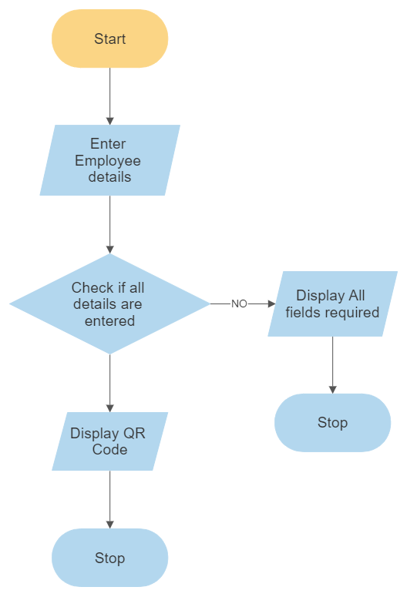
METHODOLOGY (FLOW CHART)
YES

Slide 8
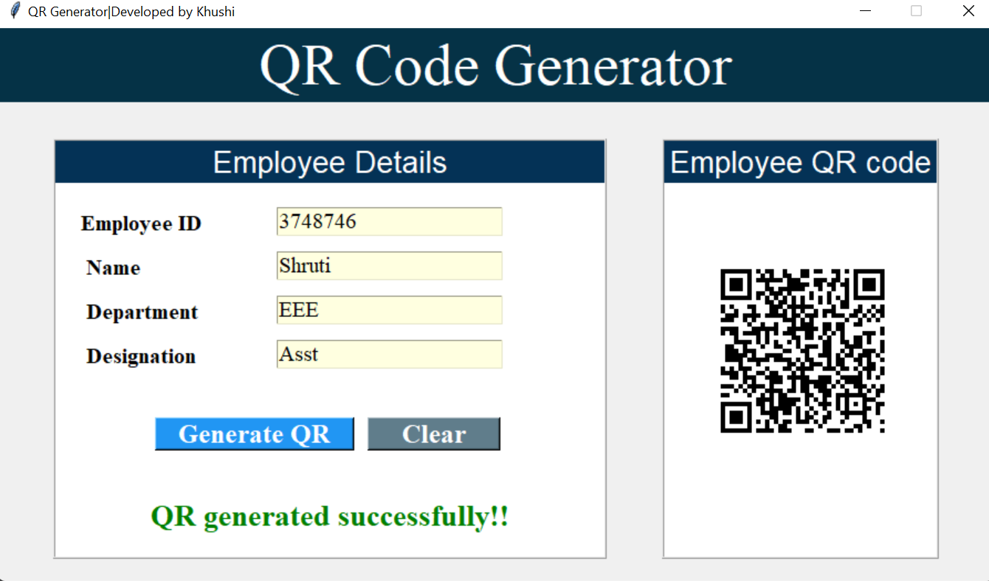
OUTPUTS
1. If all details are entered, the tool will generate a QR code:

Slide 9
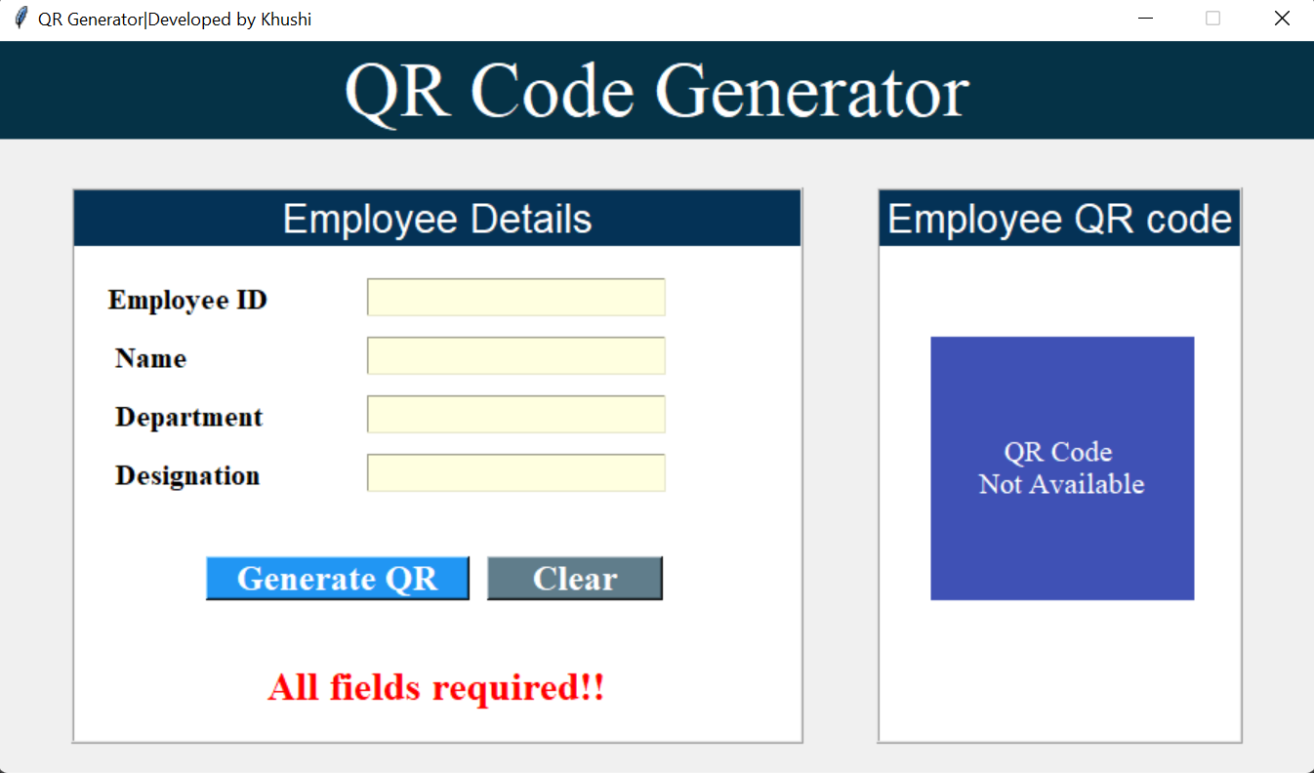
OUTPUTS
2. If details are missing, the tool will show the following message:

Slide 10

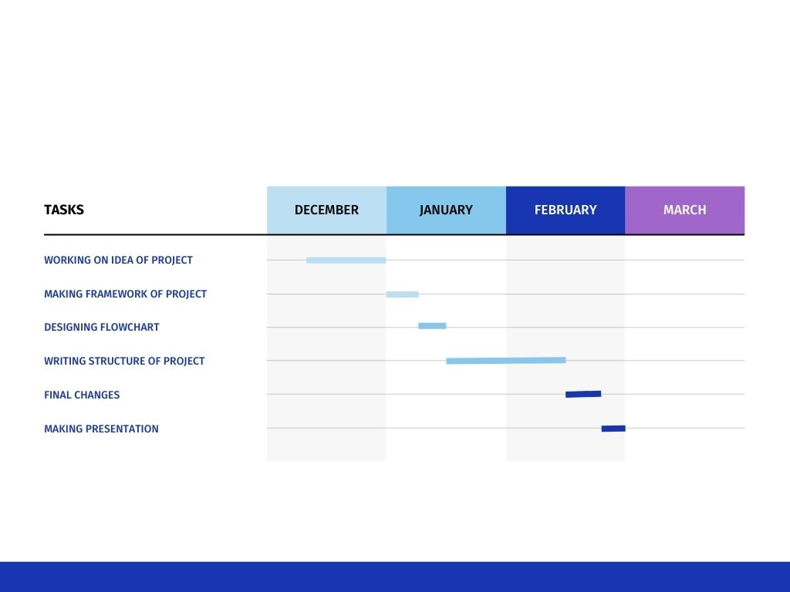
GANTT CHART

Slide 11

REFERENCES
Youtube Channel-Web code
Pypi.org
www.qrcode-tiger.com

Slide 12

THANK YOU

